Slide 1
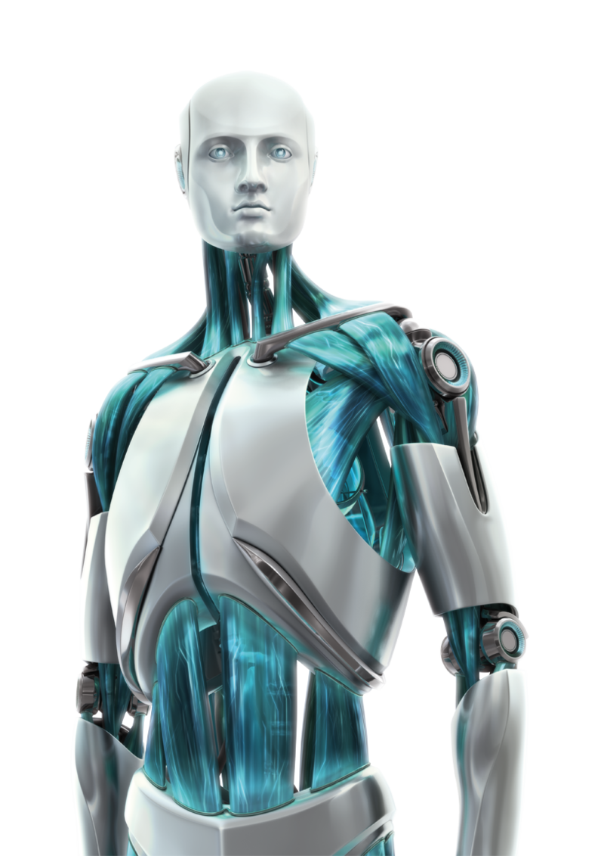

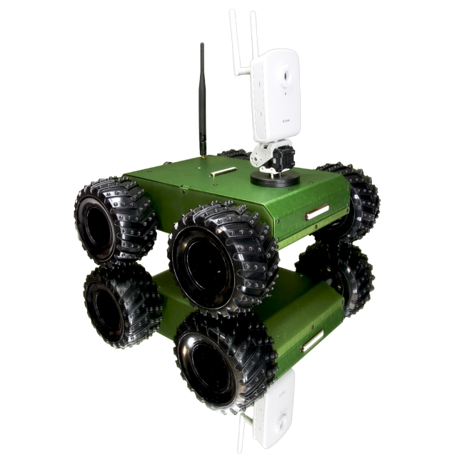
Wired Robotics Workshop
IEEE-KCCOE
Presents

Slide 2
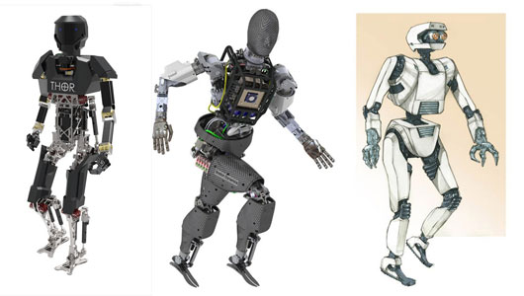
Introduction
Robotics is a branch of engineering that involves the conception, design, manufacture, and operation of robots. This field overlaps with electronics, computer science, artificial intelligence , mechatronics, nanotechnology , and bioengineering
Robotics brings together several very different engineering areas and skills.

Slide 3
Types
Wired Robot (Level 1)
Wireless
Autonomous
Semi-autonomous
IC Engine
Robotics arms

Slide 4
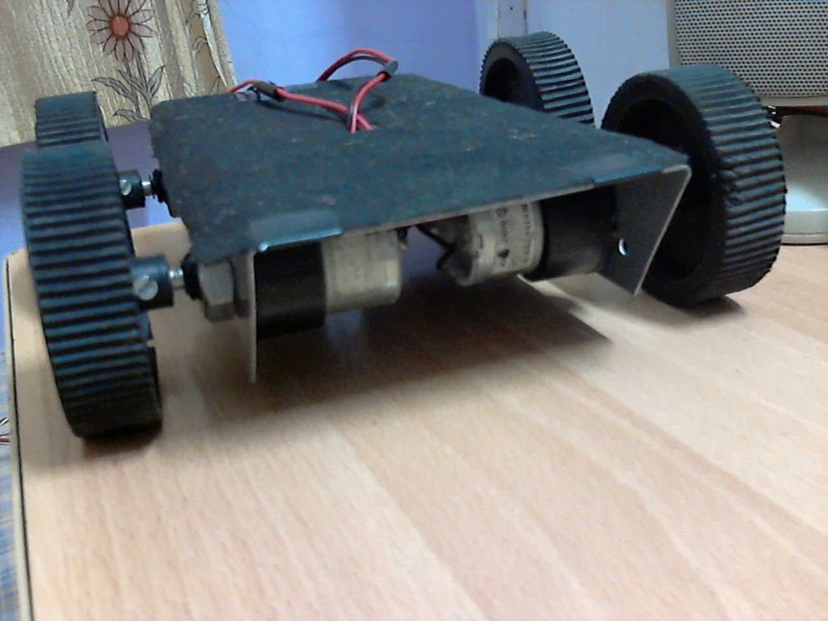
Wired Robot (Level 1)
Level 1 Robot is completely manual . A robot that must be controlled manually by someone or something. It needs to be told what to do, how to do it, and when to do it.

Slide 5
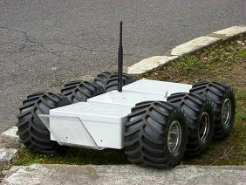
Wireless Robot
Wireless Robot has a system so that it can be controlled with a wireless joystick or controller
Notes:
Radio Frequency

Slide 6
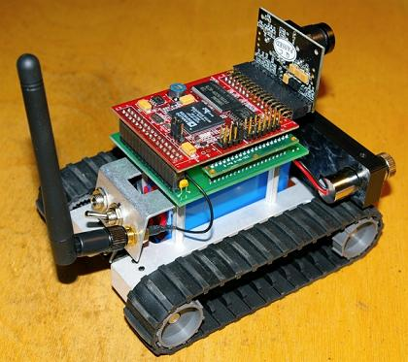
Autonomous
Autonomous robots are robots that can perform desired tasks in unstructured environments without continuous human guidance.

Slide 7
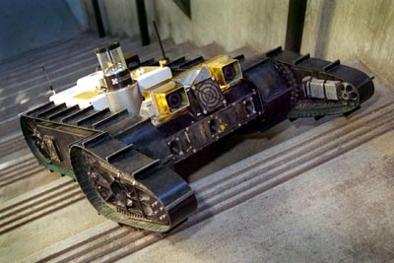
Semi – Autonomous
A semiautonomous robot is controlled by its programming and is restricted to what its programming tells it. It can not learn further than a certain point

Slide 8
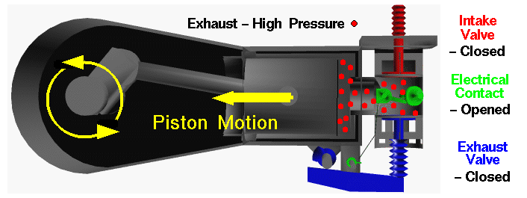
IC Engine
The internal combustion engine is an engine in which the combustion of a fuel (normally a fossil fuel) occurs with an oxidizer (usually air) in a combustion chamber that is an integral part of the working fluid flow circuit.
Notes:
Chemical to move piston into mechanical

Slide 9
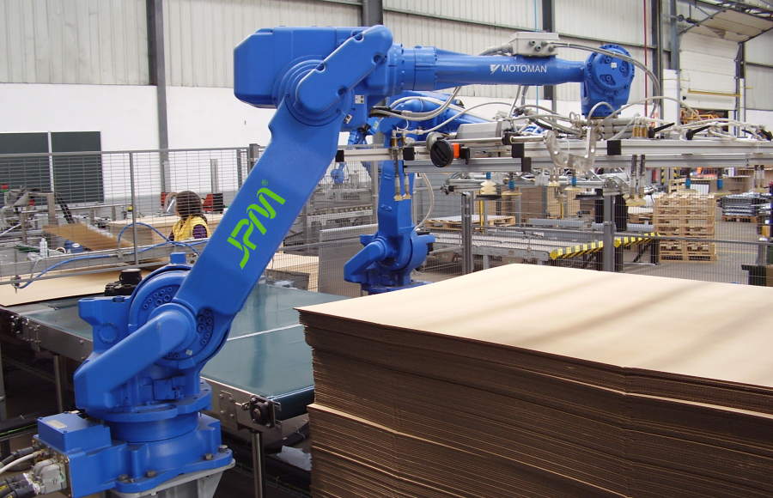
Robotic Arms
A typical robotic arm is made up of metal segments and can be joined by number of joints. The computer controls the robot by rotating individual step motors connected to each joint (some larger arms use hydraulics or pneumatics).
Notes:
Example of Tata Motors

Slide 10


Slide 11
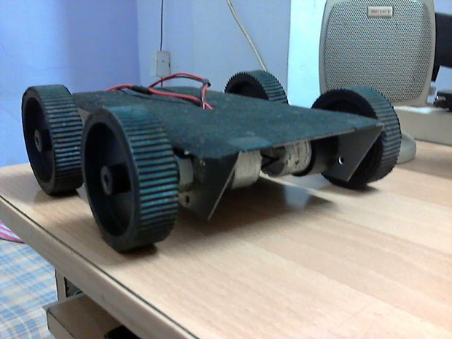
Workshop Details
Understanding the basics of robotics (Level 1)
Assembly
Connection
Level 1 Bot

Slide 12
KIT CONTENT
These are following components provided in your kit :- Power Supply (12 volt , 4.5 Ah) - 1 DPDT Switch- 2 Ribbon wire strip- 5 meters+ DC Geared Motors 4 Chassis(having holes for motor) - 1 Remote box 1 Wheels 4 Soldering wire - as required

Slide 13
Chassis
A chassis acts as an mainframe body support for man-made object in its construction and use. It is analogous to an animal's skeleton
Base on which other components are attached

Slide 14
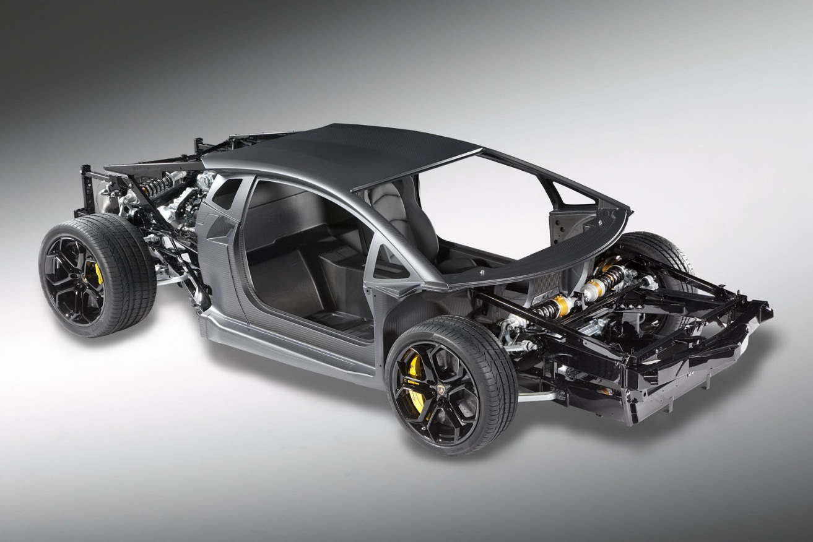
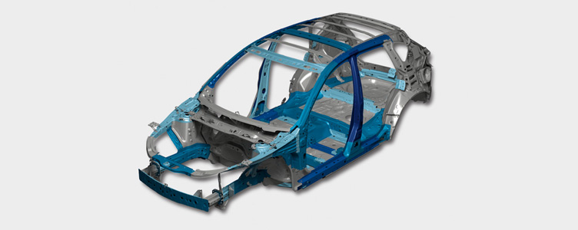
Chassis

Slide 15
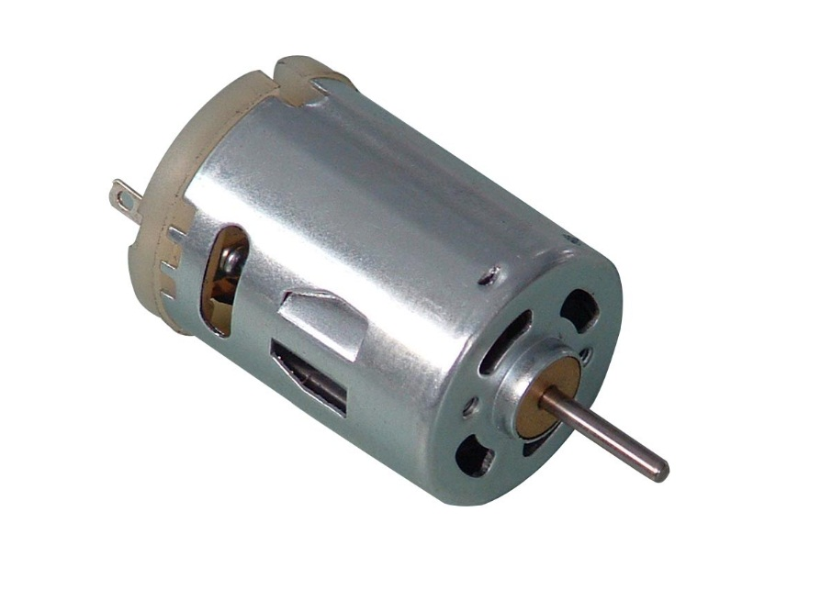
Motor
Internal Diagram of DC Motor
Types- Geared motors and Stepper motors
Notes:
Torque Speed relation

Slide 16
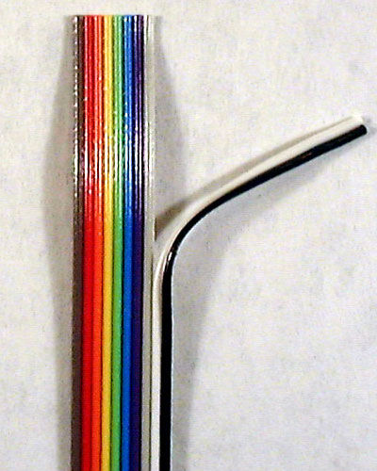
Wires
Types :- → On the basis of the structure Single Strand Multiple strand
→On the basis of thickness 1mm²
4mm² 6mm² …..etc
Notes:
Single or Multiple strand Explanation

Slide 17
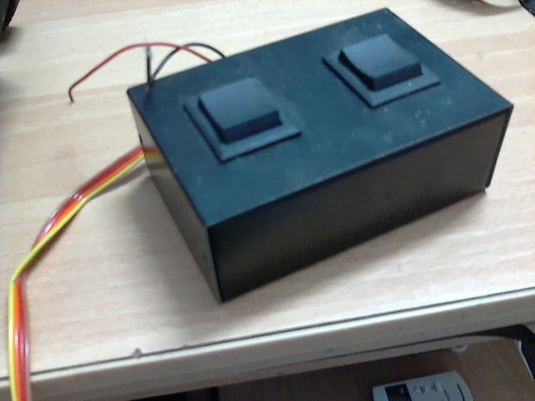
Remote Box

Slide 18
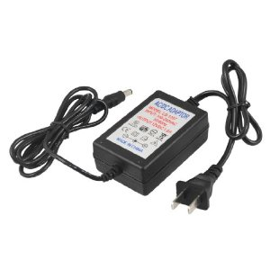
Power Supply 12 V , 4.5 Ah

Slide 19
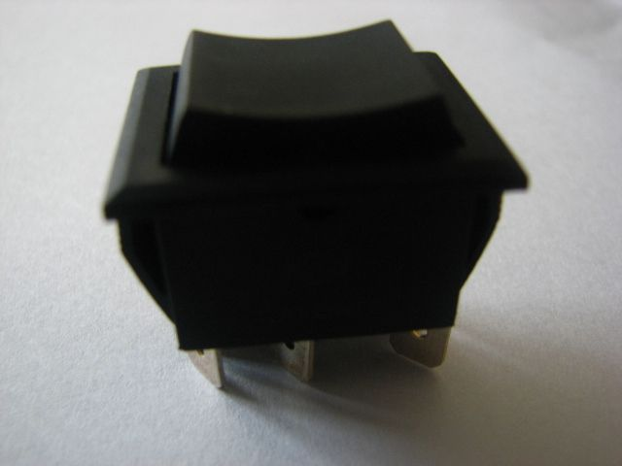
DPDT Switches Double Pole Double Throw
A DPDT switch allows the electrical relays to operate an electrical structure. The transistor devices use an electromagnet that produces a low voltage control circuit.
The way in which the DPDT switch works is through electrical voltage.

Slide 20
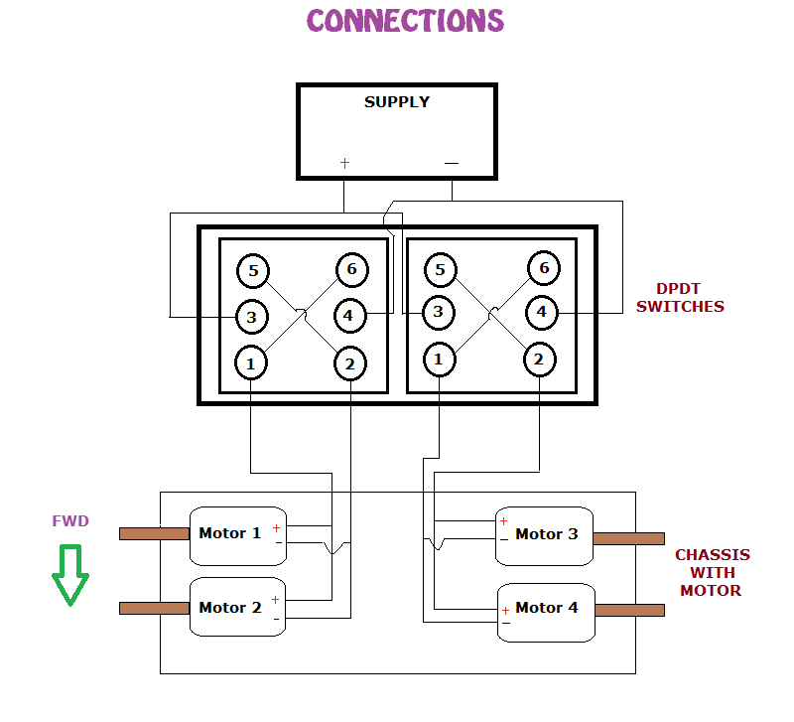

Slide 21
FUTURE MODIFICATIONS
Showcase
Videos
Pictures
Detroix Event bots

Slide 22



WEBSITE
www.ieee-kccoe.org
Join our Facebook group IEEE KCCOE Facebook page: https://www.facebook.com/official.ieee.kccoe
IEEE360DEG : https://www.facebook.com/Ieee360DegreesKccoe

Slide 23
THANK YOU!

